Slide 1
Lesson 6 UML Fundamentals(1)—
Use case & Use case Diagram
6.1 Getting started
6.2 Actor
6.3 Use case and Scenarios
6.4 How to find use case
6.5 Use case description
6.6 Conclusion

Slide 2
6.1 Getting started— What use case is ?
History:
  Ivar Jacobson，1985 PhD Dissertation “Concepts for modeling large real-time systems”
  1992 “Object-oriented software engineering： a use case driven approach”
Definition:
  A description of a potential series of interactions between a role (known as an actor) and a system, to achieve a goal.
Notes:
强调jacobson

Slide 3
6.1 Getting started – Why use case?
Every interesting system should be interacted with human or automated actors
Those actors also expects that system to behave in predictable ways
Generally, software development is use case driven
Use case is directly corresponding to the class
Use case is used to specify the behavior of a subject – a system or a part of a system – describing sequences of actions, including variants, that a subject performs to yield an observable result of value to an actor.
Advantage:
To capture the intended behavior of the system without having to specify how to implement it.
To come to a common understanding with the end users and domain experts
To help validate the architecture and to verify the system as it evolves during the development
Use case lies the central position in software development

Slide 4
6.1 Getting started– Where Use case is used?
Classification of Requirement
  Functional requirement
  Non-functional requirement
  Functional requirement
  Describe the system’s behavior(What to do?)
Non-functional requirement (What to be?)

Slide 5
6.1 Getting started —Requirement outline & Use case
Outline of System Requirement
  Goal and Scope
  Terminology Table
  Use case
  Used technology
  Developers, operation rules, Executing condition, safety requirement, document requirement
  Other questions about law, politics, organization
Use case：
  Just one part of the requirement, used to describe the functional requirement
  Independent of implementation
  Need the practice, communication ability, rich domain knowledge……
  Essentially, Use case analysis is functional decomposition technology, not an OOT

Slide 6
An simple example of Use Case
actor
use case
Process Loan
Bank::
Process Loan
LoanOfficer
Theoretically, A use case name may text consisting any number of letters, numbers, and most punctuation marks( except for marks such as colon) . However, to be more readable, the name usually is meaningful.

Slide 7
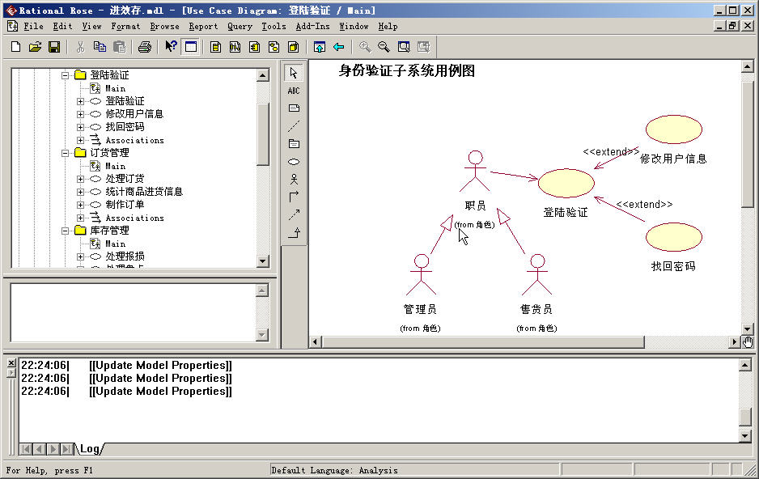
6.1 A practical example- with use case diagram
Use case diagram is used to represent a group of use cases, actors and the relationships between them
In UML, a use case model is made up of several use case diagrams
Use case diagram is used to describe the interaction of each executor in the use case, i.e., describe the external views in the opinion of the external users.
It belongs to dynamic modeling
Notes:
首先我们来研究参与者 ——

Slide 8
6.1 A practical example- with use case diagram
Functions of Use case diagram：
  Capture the system user requirement
  Describe the boundary of the system
  Designate the system’s external behavior
  Give guidance to the developer for the functional development
  Is the start point of the system. Guide the design of all class diagrams and interaction diagrams
  Produce test cases and user documents
  Estimate the person-months and the process of the project

Slide 9
6.2 Actor definition
A coherent set of roles that users of use cases play when interacting with these use cases
The same user can be different roles for the same use case → LoanOfficer & Customer
Different users can be the same role for the same use case
An actor is a person, or a thing, or even another system out of the system and plays with the system.
Actually, actor is not one part of the system.
The connection between an actor and a use case is only association. This indicates that the actor and the use case communicate with one another, each one possibly sending and receiving messages

Slide 10
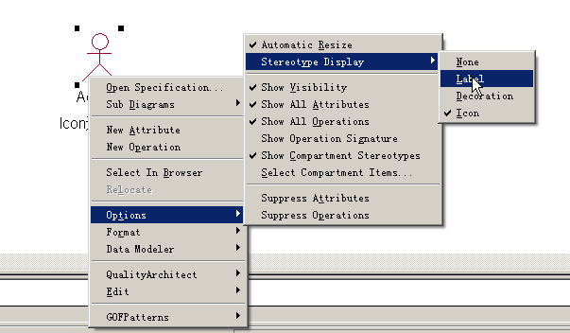
Actor– Rendering method
  Stick figure Icon：The actor is a human
  Label：The actor is an external system
  Decoration ：For both above types
<<Actor>>
Actor 1
Actor 1
Actor1
Icon
Label
Decoration

Slide 11
6.2.1 Characteristics of Actor
Out of the system boundary
Scene：
  Dr. Zhang went to bank for opening an account. After he asked transaction process from the lobby manager, he filled out the form and handed it to the counter clerk, and then he brought back the bankbook.
  Who is the actor during the process of opening an acount?
    Dr. Zhang, Lobby manager, Clerk, Form or the bankbook?
Two useful questions for finding the answer
  Who has clear requirement and aim for the system, and act actively？
  Who is the system for?
Notes:
小张开户！
大厅经理和柜台职员是什么？业务工人，business worker

Slide 12
6.2.1 Characteristics of Actor
Actor is not necessarily a human
Scene：
  Automatically calculate the number of visitors of the webpage, and then generate the statistical form. Lastly, send it to the manager
  Who is the actor?
    Manager？
There doesn’t exist the use case without the actor. The use case should not be started up actively, and should not start up another use case
There must be a thing ——
  Here ——Counter!!!

Slide 13
6.2.2 How to find actor?
Several questions：
  Who is responsible for providing, using, or deleting the information?
  Who will use this function?
  Who is interested to the special function?
  Where will the system be used in the organization?
  Who is responsible to support/maintain the system?
  What external resources does the system have?
  What other systems will interact with the system?

Slide 14
6.2.2 How to find actor?
Example：Who is actor of the ticket booking system?
  A person bought the ticket by Internet
    The person buying the ticket
  A person contacted the call-center and then the worker bought the ticket for him by operating the system
    The worker
  A person call the auto-voice-service call-center to book the ticket
    call-center
  The system boundary is enlarged, call-center becomes a subsystem of the ticket booking system. The person can select a booking mode arbitrarily
    The person buying the ticket

Slide 15
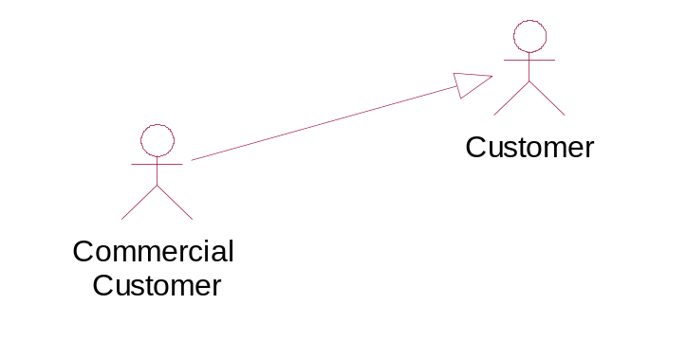
6.2.3 Relationship between actors
Generalization
Similar to the Inheritance relationship in OOT
Is the association relationship between a generic actor(named as Parent actor) and a special actor (named as Child actor)
Child actor inherits the behavior and semantics of the parent actor. Meanwhile, it can add its own special behavior and semantics.
The child actor can be used in wherever the parent actor is used

Slide 16
6.3 Use case & Scenario
Use case is used to define a set of use case instances. Each instance represents a series of operation the system will execute. And some observable value can be obtained from these operations
  Use case instance —— Scenario
In UML，use case is noted as a ‘ellipse’. And use case is usually named as the structure of “verb-object structure” or “sub – verb structure”. For example:
Withdraw Money
Login the system
Create Index

Slide 17
6.3 Use case & Scenario
In UML, Scenario is used to represent a onefold path running through the use case. And thus used to represent a special case of the use case.
  Scenario is the instance of use case
For each use case, it has a series of scenarios,
  One of which is the primary scenario, the others are the secondary scenarios. Compared the primary scenario, the secondary scenarios are used to describe the exceptional or alternative paths.

Slide 18


6.3.1 The characteristics of the use case
Use case is relatively independent
  Functionally complete
Correct use case
Depositor
Withdraw money
Wrong use case
Depositor
Fill the withdrawal form

Slide 19


6.3.1 The characteristics of the use case
The execution result is observable and meaningful for the actor
Correct use case
Depositor
Login the system
Wrong use case
Depositor
Input the password

Slide 20


6.3.1 The characteristics of the use case
Use case must be activated by an actor
  There is no use case without Actor
  Use case shouldn’t be startup automatically, and can’t be used to startup another use case
Wrong use case
ATM
Spit out Money
Correct use case
Depositor
Withdraw Money

Slide 21


6.3.1 The characteristics of the use case
The name of a use case must have the structure of verb-objective
Correct use case
A person
Eat rice
Wrong use case
A person
Eat

Slide 22
6.3.1 The characteristics of the use case
A use case is
  A requirement unit,
  An analysis unit,
  A design unit,
  A development unit,
  A test unit, even a deployment unit
Use case driven software engineering

Slide 23
6.3.2 Relationships
Two Types of relationship:
Relationship between use case and actor：
  Association
Relationships between use cases：
  Include —— stereotype from dependency <<include>>
  Extend —— stereotype from dependency <<extend>>
  Generalization —— inheritance

Slide 24
6.3.2 Include relationship
Definition
  Used to describe the behavior of one use case ( base use case) incorporates the behavior of another use case ( included use case）
  Include is a stereotype of dependency, i.e., is a special dependency relation
  Arrow direction is the included use case. Base use case depends on the included use case
Application：
  Is used to avoid describing the same flow of events several times by putting the common behavior in a use case of its own
  Similar to define a sub-process in process design language. After that, call the sub-process from the main process.
The included use case never stand alone
<<include>>
Manager
Maintain the users’
information
<<include>>
Create a user account
User
Register
Notes:
Similar to What → Sub function (子函数）

Slide 25
6.3.2 Extend relationship
Definition
  To specify that one use case (extension) extends the behavior of another use case (base)
  Similar to the inheritance relationship. However, several extension points should be given and the base use case may be extended only at the extension points.
  The base use case is defined independently and is meaningful by itself, the extension use case is not meaningful on its own
  The extension use case can access and modify the attributes of the base use case; however, the base use case is not aware of the extension use case and, therefore, cannot access or modify the attributes and operations of the extension use case
  Is a stereotype of dependency relationship, is a special dependency.
  The arrow direction is from the extension use case to the base use case
Employee
Execute query
<<extend>>
<<extend>>
Export query result
Print query result
Notes:
英文书P.236倒数 第二段 第一句话 好象 说反了？ 不对…….

Slide 26
6.3.2 Extend relationship
Application：
  To model a relatively-independent and optional behavior. In this way, you separate optional behavior from the mandatory behavior.
  To model a separate subflow that is execute only under given conditions.
  To model several flows that may be inserted at a certain point, governed by explicit interaction with an actor.
Example
You are developing an e-commerce system in which you have a base use case called Place Online Order that has an extending use case called Specify Shipping Instructions. An extend relationship points from the Specify Shipping Instructions use case to the Place Online Order use case to indicate that the behaviors in the Specify Shipping Instructions use case are optional and only occur in certain circumstances.

Slide 27
6.3.2 Generalization relationship
Definition
  Is just like the generalization relationship among classes. Means that the child use case inherits the behavior and meaning of the parent use case.
Application：
  The child use case and the parent use case are similar and has more special behavior；the child use case will inherit all the structure, behavior and relationships of the parent use case
  The child use case may add to or override the behavior of its parent. Generally, the parent use case is abstract.
  Actually, the generalization relationship is rarely used. The special behavior of child use case can be regarded as the alternative subflows of the parent use case
Leader
Approval
Approval of wage
adjustments
Approved leave
of absence

Slide 28
6.3.2 Comparison of the relationships
“Extend” →“is a”
  Used to describe the variants of the normal behavior when more control modes are needed. → It can be implemented by setting extension points
  The base use case must be a well formed use case, i.e., it can exist independently. When the base use case is executed, the extension part may or may not be executed
  Base use case doesn’t know whether there may be extension use cases. However, the extension use case must be extended from the base use case from some extension points
Employee
Execute query
<<extend>>
<<extend>>
Export query result
Print query result

Slide 29
6.3.2 Comparison of the relationships
“Include” →“has a”
  If two or more use cases are needed to dealt with repeatedly, “Include” is used to implement the reference of one use case to another use case
  The base use case may or may not be well formed. The included use case must be executed when the base use case is executed
  The base use case must know where there is the included use case. However, the included use case doesn’t know whether there may be base use case
“Generalization” →“is a”
  Used to deal with the variants of the normal behavior and is used occasionally
<<include>>
Manager
Maintain the users’
information
<<include>>
Create a user account
User
Register

Slide 30
6.3.2 Comparison of the relationships
Track order:
obtain and verify the order number;
include ‘Validate user’;
For each part in the order,
query the order status;
report overall status to user.
Place order:
include ‘Validate user’;
collect the user’s order items;
set priority: extension point;
submit the order for processing

Slide 31
6.4 How to find use case?
Method & Steps
  Find the external actor or external system, and then determine the boundary and limit of the system
  Determine the expected system behavior of every actor
  Define these system behaviors as use case
  Define the common part and the variant part of the system behavior by using “generalization”, ‘include” and “extend” relationship
  Organize the scenarios of every use case
  Draw use case diagram
  Differentiate the main and exceptional event flow. If necessary, the exceptional event flow can be treated as a separate use case
  Refine the use case diagram, and solve the problems such as repetition or conflict between the use cases

Slide 32
6.4.1 The principle to find use case
Heuristic principles
  Communicate with the user
  Regard yourself as the actor
  Don’t separate the determination of use case and determination of the actor
Principles proposed by Jacobson
  What is the main task of the actor?
  What information does the actor need to know?
  What information does the system need to be modified?
  Is it necessary for the actor to inform the system the external change?
  Does the actor hope to know the exceptional change of the system?

Slide 33
6.4.2 An example to find use case –ATM
Requirement of the customer:
Support inter-bank business;
Support to select withdrawing or saving after the card is inserted
To facilitate the use, set some buttons with default number
Support to modify the password and Report the loss
Support to pay the fee of telephone, water, electricity
For safety, there should be warning message about the cheater
There should be a camera
The card should be expropriated automatically if the wrong PIN number is input for three times

Slide 34
6.4.2 example –cont’
Use case name | Effective？ | Reason
Support inter-bank business
Insert the card
Input the password
Select the service
Withdraw money
Deposit
Report the loss
Pay the fee
Cheater warning
Expropriate the card if three times of wrong PIN number

Slide 35
6.4.2 example –cont’
Use case name | Effiective？ | Reason
Support inter-bank business | X | Business rule
Insert the card | X | Process step
Input the password | X | Process step
Select the service | X | Process step
Withdraw money | √
Deposit | √
Report the loss | √
Pay the fee | √
Cheater warning | X | ……
Expropriate the card if three times of wrong PIN number | X | Business rule

Slide 36
6.5 Use case description
Use case description is the main part of use case. It is imperative for the analysis of interaction diagram and class diagram
Function：
  To determine the function when the use case is finished
  To describe the behaviors of the actor and the system when they interact with each other
Method：
  Using natural language→ formal language will limit the humans to understand
User：
  Developer, user, Project manager, tester

Slide 37
6.5.1 Contents of use case description
There is no uniform format
Task of the use case
How to start the use case
How to send the message between actor and use case
Other paths besides the main path
The system state after the use case is finished
Other necessary information
Principle：As sufficient as possible
Use the uniform format in the same corporation

Slide 38
6.5.2 Template for use case description
Despt. Item | Explanation
Use case ID | A unique integer sequence number identifier . Alternatively, use a hierarchical form: X.Y. Related use cases can be grouped in the hierarchy and can be used in other places.
Use Case Name | State a concise, results-oriented name for the use case. These reflect the tasks the user needs to be able to accomplish using the system. Include an action verb and a noun. Some examples: View part number information. Manually mark hypertext source and establish link to target. Place an order for a CD with the updated software version.
Created By | Supply the name of the person who initially documented this use case
Date Created | Enter the date on which the use case was initially documented
Last Updated By | Supply the name of the person who performed the most recent update to the use case description
Date Last Updated | Enter the date on which the use case was most recently updated
As a whole, the description can be divided into two parts:
    Use case Identification
    Use case Definition

Slide 39
Description | Provide a brief description of the reason for and outcome of this use case, or a high-level description of the sequence of actions and the outcome of executing the use case.
Actors | the list of persons or other entities external to the software system being specified who interacts with the system and performs use cases to accomplish tasks
Trigger | Identify the event that initiates the use case. This could be an external business event or system event that causes the use case to begin, or it could be the first step in the normal flow
Priority | Indicate the relative priority of implementing the functionality required to allow this use case to be executed. The priority scheme used must be the same as that used in the software requirements specification. “1” is the highest
State[O] | The state of the use case. Usually, there are the following states: under way, waiting for check, pass, failed to pass
Preconditions | List any activities that must take place, or any conditions that must be true, before the use case can be started. Number each precondition. Examples: ……
Postconditions | Describe the state of the system at the conclusion of the use case execution. Number each postcondition. Examples: ……

Slide 40
6.5.2 Template for use case description
Normal Flow | Provide a detailed description of the user actions and system responses that will take place during execution of the use case under normal, expected conditions. This dialog sequence will ultimately lead to accomplishing the goal stated in the use case name and description
Alternative Flows | Document other, legitimate usage scenarios that can take place within this use case separately in this section. State the alternative flow, and describe any differences in the sequence of steps that take place. Number each alternative flow in the form “X.Y”, where “X” is the Use Case ID and Y is a sequence number for the alternative flow.
Exceptions | Describe any anticipated error conditions that could occur during execution of the use case, and define how the system is to respond to those conditions. Also, describe how the system is to respond if the use case execution fails for some unanticipated reason. If the use case results in a durable state change in a database or the outside world, state whether the change is rolled back, completed correctly, partially completed with a known state, or left in an undetermined state as a result of the exception. Number each alternative flow in the form “X.Y.E.Z”, where “X” is the Use Case ID, Y indicates the normal (0) or alternative (>0) flow during which this exception could take place, “E” indicates an exception, and “Z” is a sequence number for the exceptions.

Slide 41
6.5.2 Template for use case description
Generalizes | List any other use cases that are generalized from this use case.
Includes | List any other use cases that are included (“called”) by this use case.
Extends | List any other use cases that are extended from this use case.
Notes and Issues[O] | List any additional comments about this use case or any remaining open issues or TBDs (To Be Determineds) that must be resolved. Identify who will resolve each issue, the due date, and what the resolution ultimately is.
Decisions[O] | The list of key decisions, used to maintenance of the system.
Frequency of Use[O] | Estimate the number of times this use case will be performed by the actors per some appropriate unit of time ( month, week, ……).
Assumptions | List any assumptions that were made in the analysis that led to accepting this use case into the product description and writing the use case description.
Business Rules | List any business rules that influence this use case
Special Requirements | Identify any additional requirements, such as nonfunctional requirements, for the use case that may need to be addressed during design or implementation. These may include performance requirements or other quality attributes

Slide 42
6.5.3 A description example
Descript Item | Explanation | Descript. Item |  | Explanation
Use case ID | UC1701 | Use case Name |  | Order handling
Created By | ZHANG San | Date Created |  | 2010/03/13
Last Updated By | LI Si | Date Last Updated |  | 2010/12/29
Description | It starts from the order initialization or query. It is used to deal with order initialization and authorization. It ends when the processor finishes the dialog for the same customer.
Actors | Order processor
Trigger | Order initialization |  | Priority | 1
State[O] | Passed |  | Preconditions | The order processor login the system
Postconditions | Give the order ：The number in the warehouse decreased
Normal Flow | 1. The customer gives an order of a guitar, and use the debit card for payment…… 2. ……

Slide 43
6.5.3 A description example
Alternative Flows | （may have four alternative flows） 2.1 The customer gives an order of a guitar, and use bank draft for payment…… 2.2 The customer gives an order of a guitar, and use credit for payment…… 2.3 The customer gives an order of a guitar, and use credit for payment. However, the card is invalid…… 2.4 The customer gives an order of a guitar. However, there is no stock now……
Exceptions | No | Notes and Issues[O] | No
Generalizes | No | Decisions[O] | No
Includes | No | Frequency of Use[O] | 100 / day
Extends | No | Assumptions | No
Business Rules | ……

Slide 44
6.5.4 The mistakes that often occur for use case description
Only describe the system behaviors, not including the actor’s behaviors
Only describe the actor’s behaviors, not including the system behaviors
Specify the req. of the interface
Too long description
The description of use case is too long
The description of use case is not clear
Use case can’t end normally
The user can’t understand the use case
Too many use case definition
Too complex the relationship between the use case and the actor
………

Slide 45
6.6 Conclusion
Use case is put forward by Ivar Jacobson，use case driven software development has been widely agreed.
Use case is used to specify the interacted action series between the system, subsystem, or class and external actor
Use case is usually named as verb-object or subject-verb structure
Requirement is divided into functional requirement and non-functional requirement. Use case is used to deal with the functional requirement.
The relationship between use case can be generalize, include, extend
Scenario is the instance of use case.
Actor is the thing out of the system and that will use or interact with the system. For example, the person, device, and external system.
There may be generalization relationship between the actors.
Use case description is the primary part of the use case
There is no standard format for use case description. Different corporations will have their own formats
The quality of use case is heavily dependent on the experience and the domain knowledge

Slide 46
UML Homework (1)
Selecting an example by yourself:
  Involve at least two actors
  Include at least five use cases
  Apply the relationship “include” and “extend”
  Select one of the use cases, and describe at least four scenarios.
Using Rose/MagicDraw/……：
  Draw the use case diagram
  Draw the sequence diagram and collaboration diagram of 4 scenarios of the use case
Email to me— zjucse163@163.com
  Email Title —— UML-1-Name-Student ID
  Deadline —— 2018.12.16 23:59:59

